Slide 1
CREDIT CARD CUSTOMER SEGMENTATION
MENTOR: MR. ANUJ SAINI
SCRUM MASTER: MR.ADITYA SHAH
TEAM MEMBERS: JAY SHAH
JINI BHANUSHALI
MITALI PATIL
RADHA SAWANT

Slide 2
OUTLINE
Introduction
Problem Statement
Objectives
Project Architecture
Preparation of Data
Exploratory Data Analysis
Column wise analysis of data
Feature Engineering Selection/Creation
K-Means
What we are doing
Model 1
Model 2
Conclusion

Slide 3

JOURNEY
TECHNICAL Numpy Pandas Matplotlib Seaborn Sklearn Flask HTML CSS | CONCEPTS EDA Feature Engineering Machine Learning Unsupervised Learning Kmeans DBSCAN Autoencoder | TOOLS GIT Agile Microsoft Teams Word Documentation Google slides presntation

Slide 4
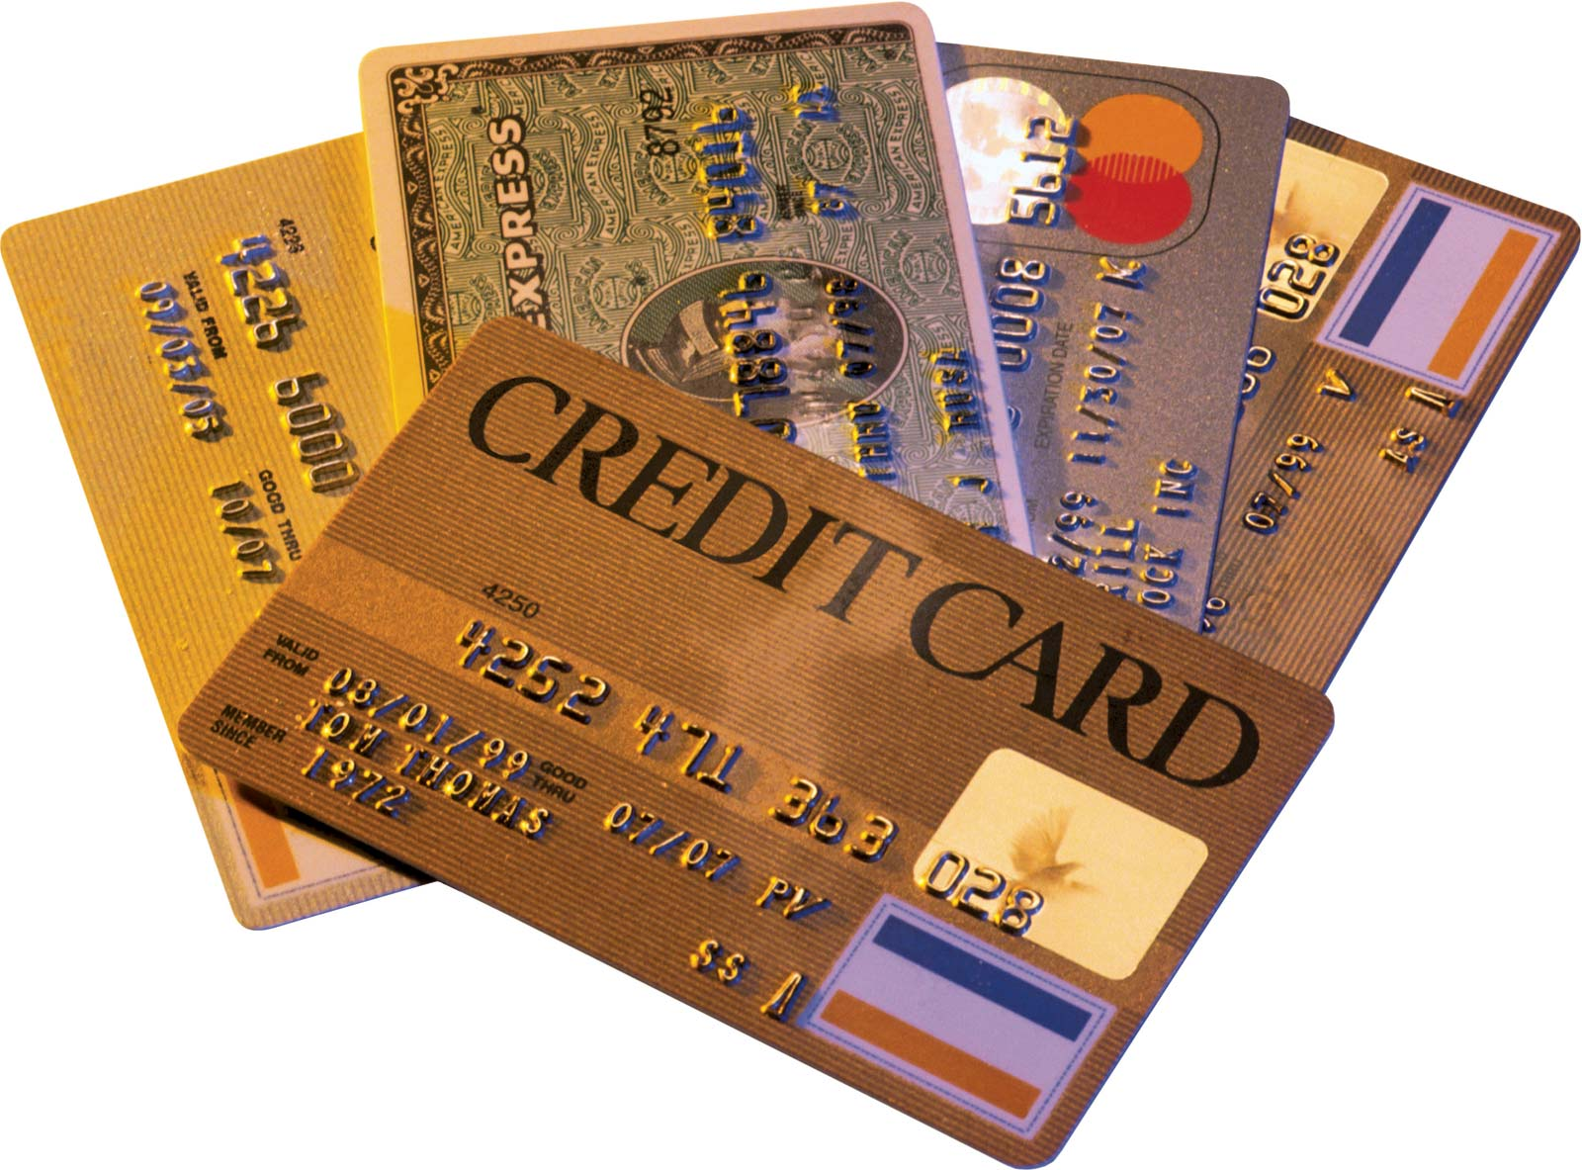
INTRODUCTION
Credit cards are a very important source of revenues for Banks all over the world! Issuers find it difficult to differentiate between their customers based on their behaviours and payment or spending patterns.
Customer segmentation is the practice of dividing a customer base into groups of individuals that are similar in specific ways. A customer segmentation model allows for the effective differentiation of customers and gives the issuers an insight on how they can attract them to use their cards more or attract new customers with new schemes.

Slide 5
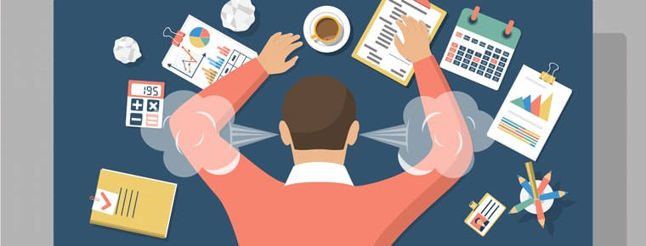
PROBLEM STATEMENT
RBL’s marketing department collects various customer specific data of the credit card holders.
They need a mechanism to segment the customer based on underlying characteristics and form market clusters which will be easy for them to target and provide product ideas to the management.
Currently these tasks are performed manually by trusting the judgment of experts in the field. These can lead to human error, biased decision and other factors which may not be helpful to create a customer cluster that actually exist.
They want to design a system that would
automate this process and help the different
stakeholders to make informed business
decision.

Slide 6
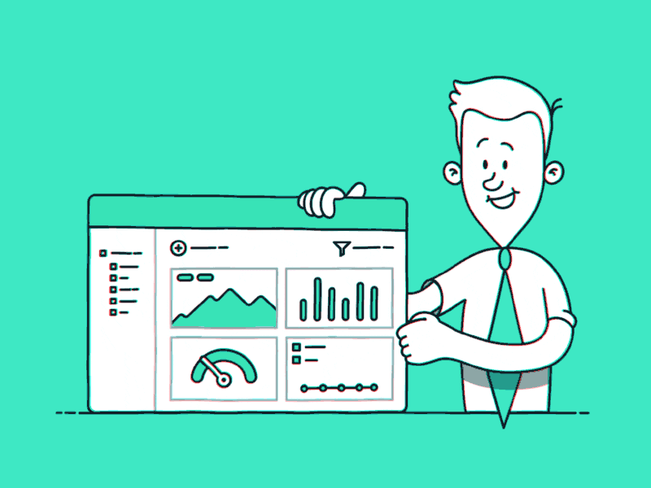
OBJECTIVES
To develop a solution focused on developing a clustering algorithm based on unsupervised learning.
Try various clustering algorithm, and identify the best model for the business scenario and build and fine tune them based on characteristics.
Deploy the machine learning model using Flask API and
pickle files.
Design a UI for entering model inputs and display
results accordingly.

Slide 7
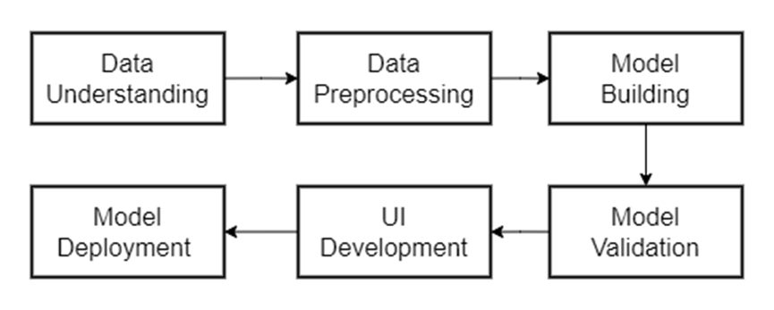
PROJECT ARCHITECTURE

Slide 8
PREPARATION OF DATA:
Loaded the dataset into Jupyter IDE and import all necessary libraries that will be needed for analysis.
Performed initial analysis of the provided dataset, checking the format and type of the various numerical and categorical columns.
Reduced the functional/business sense of each of those columns, their relevance in predicting the business solution and form initial hypothesis of the most critical features which could be crucial in designing the model.
Column CREDIT_LIMIT with only one row having null value was dropped from the dataset. Column MINIMUM_PAYMENTS had around 313 missing rows.
Column CUST_ID was dropped from the dataset, since no business sense can be derived from it and does not add value to our insights.

Slide 9
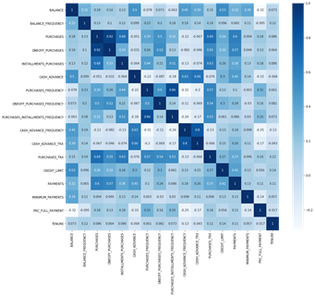
EXPLORATORY DATA ANALYSIS
HEAT MAP
"PURACHASES_INSTALLMENTS_FREQUENCY" has strong positive correlation with "PURCHASE FREQUENCY"
"BALANCE" has a strong negative correlation with "PRC_FULL_PAYMENT"
"TENURE" has almost no correlation with any (No linear relationship)
Purchases and OneOff_purchase have positve correlation of 0.92 PURCHASES_FREQUENCY and PURCHASES_INSTALLMENT_FREQUENCY 0.86 CASH_ADVANCE_TRX and CASH_ADVANCE_FREQUENCY has positive correlatuion of 0.8

Slide 10
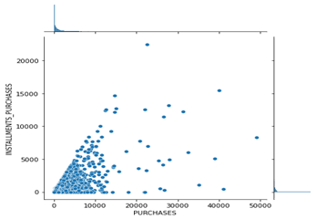
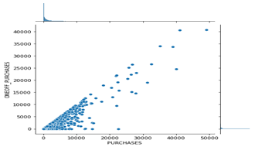
COLUMN WISE ANALYSIS OF DATA
Purchases vs Installment purchases
Purchases vs one-off purchases
This shows that there is a linear correlation between both the graphs which also because of the fact that one off purchase is a result of subtraction of installment purchases from purchases so we can discard one of these columns.

Slide 11
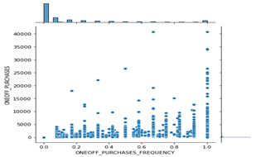
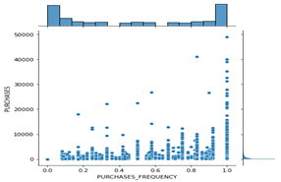
one-off purchases vs on-off purchase frequency
purchases vs purchases frequency
We can discard one of the columns from one-off purchases and its frequency as it shows frequency increasing with purchase increasing and the same for purchase and its frequency and same for purchase installments and its frequency

Slide 12
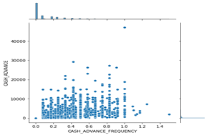
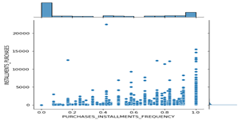
cash advance vs cash advance frequency
Installment purchases VS Installment purchase frequency
cash advance and its frequency shows no trend.

Slide 13
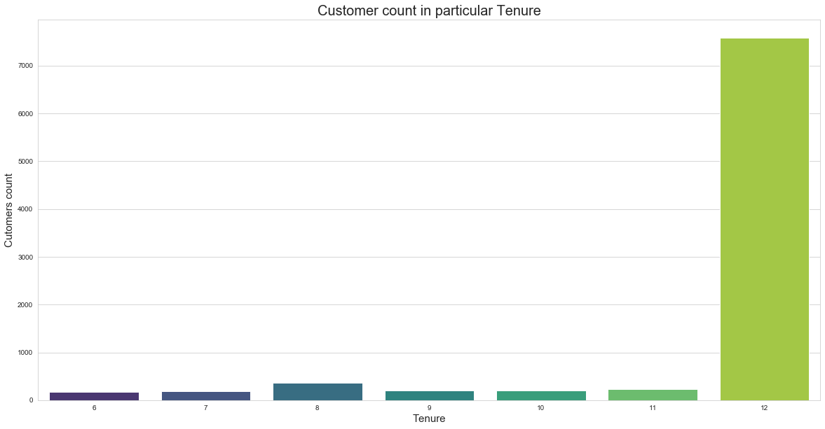
TENURE
Most of the customers have 12 months as their Tenure. So further analysis of the data set.

Slide 14
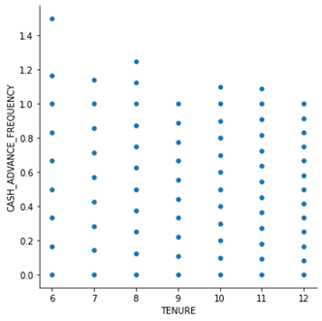
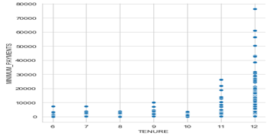
Tenure vs Cash Advance Frequency
Old customer with 12 years has cash frequency less than one the new customer who takes more cash advance.
Tenure vs Payments
More the tenure more minimum payment.

Slide 15
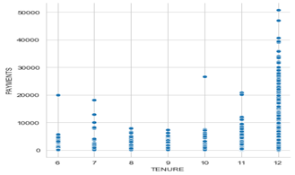
Tenure vs Payments
More payments mean customer is old customer because they are more familiar with the payment system.
INSIGHTS: Customers with a tenure range of 12 months have Higher spending power, they also pay the credit amount, and take the least cash advance.

Slide 16
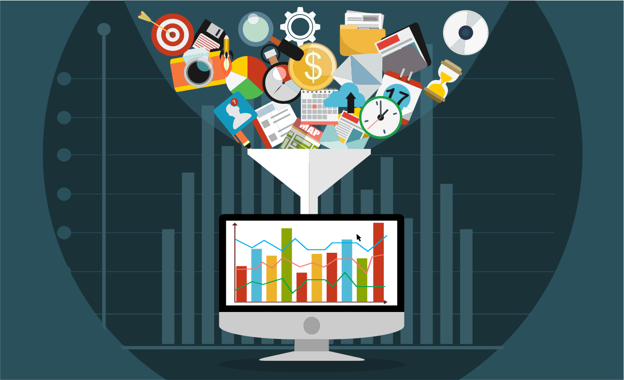
FEATURE ENGINEERING SELECTION/ CREATION
Feature Engineering during EDA.
The feature engineering and the new features that were created are.
TOT_TRX column was created by adding the PURCHASES AND CASH ADVANCE.
Average cash advance was created by dividing cash advance by its tenure.
Average purchases were created by adding dividing purchases by its tenure.

Slide 17
K-MEANS
K -Means algorithm is an iterative algorithm that tries to partition the dataset into Kpre-defined distinct non-overlapping subgroups (clusters) where each data point belongs to only one group. It tries to make the intra-cluster data points as similar as possible while also keeping the clusters as different (far) as possible. It assigns data points to a cluster such that the sum of the squared distance between the data points and the cluster’s centroid (arithmetic mean of all the data points that belong to that cluster) is at the minimum. The less variation we have within clusters, the more homogeneous (similar) the data points are within the same cluster.
The other algorithms wwe studied were Hierarchical clustering, DBSCAN,Autoencoder.
We Used K-Means.

Slide 18
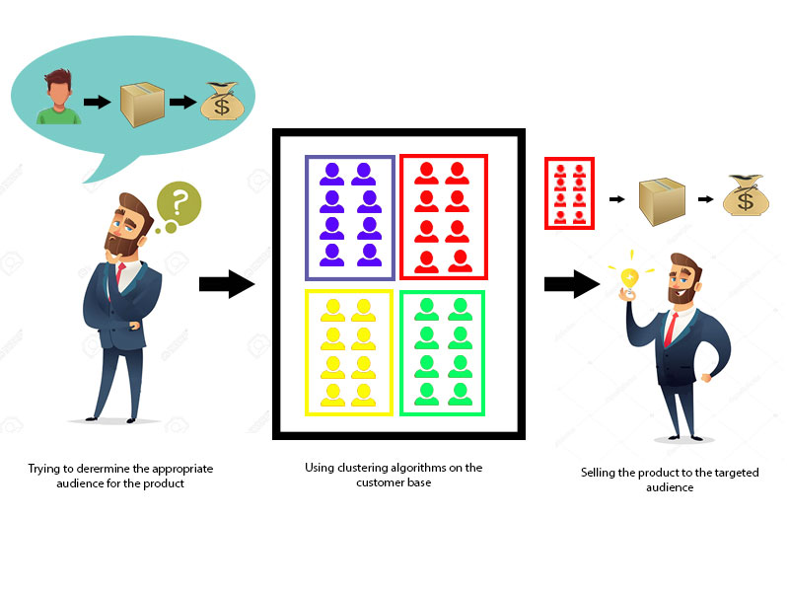
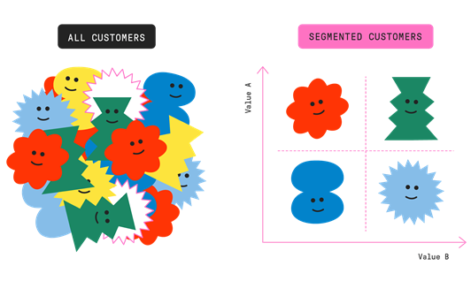
WHAT ARE WE DOING

Slide 19
MODEL 1

Slide 20
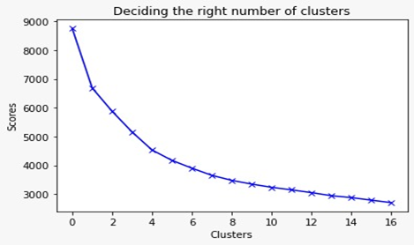
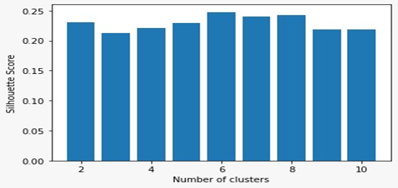
NUMBER OF CLUSTERS
Elbow Method
SILHOUETTE

Slide 21
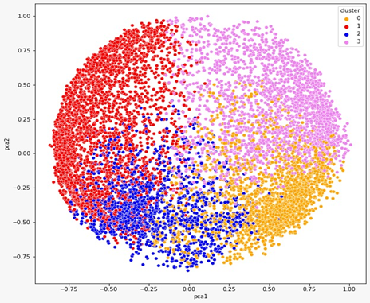
CLUSTERS
Cluster 0 (Gold)
Cluster 1 (Silver)
Cluster 2 (Bronze)
Cluster 3 (Platinum)

Slide 22
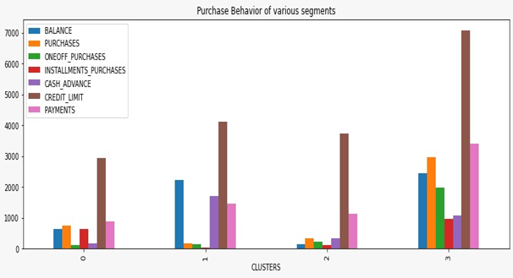

Slide 23
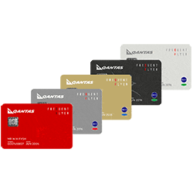
BUSINESS INSIGHTS
Cluster 0 (Gold): Customers of cluster 0 have a pretty good credit limit and balance but these customers have a very low one-off purchase and purchases in comparison to cash advance. This means they take more cash advance and spend less through purchasing. These customers should be given schemes accordingly to increase their purchase which will indirectly increase one-off purchase and installment purchases.
Cluster 1 (Silver): Credit limit of customers of cluster 1 is lowest amongst all. These customers have a low balance but they have quite high purchase and installment purchases. These customers have a very low one-off purchase and cash advance.

Slide 24
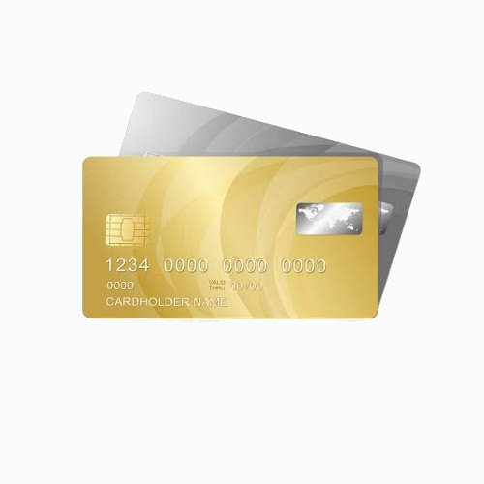
BUSINESS INSIGHTS
Cluster 2 (Bronze): These customers have a good credit limit but their balance, one-off purchase, purchases, installment purchases is very low. So, these customers should be encouraged by giving schemes to spend more and to increase the balance by keeping a minimum balance
Cluster 3 (Platinum): These customers have the highest credit limit and one-off purchase followed by purchases and installment purchases. They have highest payment of all clusters. These customers should be encouraged to keep decent balance in their account by keeping a minimum balance rule

Slide 25
MODEL 2

Slide 26
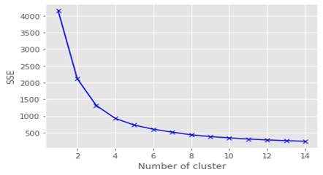
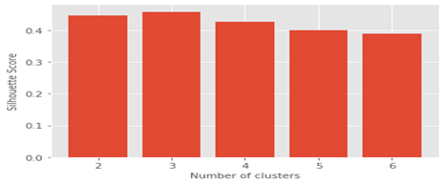
NUMBER OF CLUSTERS
ELBOW METHOD
SILHOUETTE

Slide 27
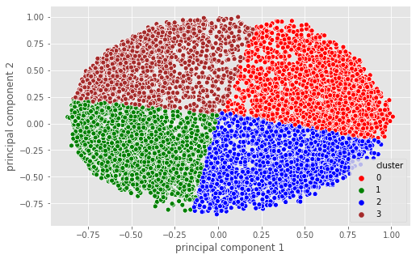
CLUSTERS
GROUP 0- Middle Class But Good Buyers
Group 1 - Rich But Purchase less
Group 2- Cream Customers
Group 3 -Poor and Inert

Slide 28
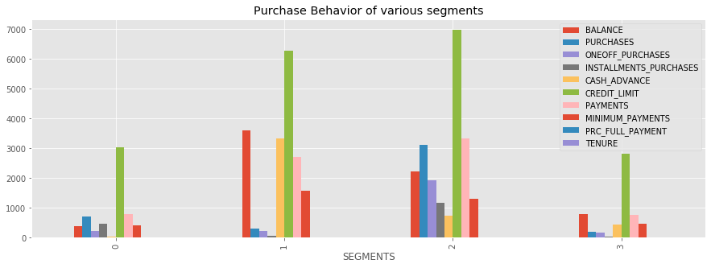

Slide 29

BUSINESS INSIGHTS AND RECOMMENDATION
GROUP 0 - Middle Class But Good Buyers
BUSINESS INSIGHTS: Their Balance is very less but still they purchase without taking much cash advance and prefer installments to do the purchases.They make sure to repay the installments on time.
BUSINESS RECOMMENDATION : These are good customers and even with less balance are managing to purchase So we should give them schemes where they can have discounts on some expensive products so that they are attracted to buy more stuff since they are frequent buyers.They are quite a number of people in this group so the company should definitely focus more on them.

Slide 30

BUSINESS INSIGHTS AND RECOMMENDATION
Group 1- Rich But Purchase less
BUSINESS INSIGHTS: They are rich people with a lot of balance but not frequent buyers.Even with a lot of balance they still take a lot of cash advance to purchase suggesting that they buy expensive items.They are new customers and a few in quantity. BUSINESS RECOMMENDATION: In order to make them shell their money we need to provide them schemes for expensive items as well as the ordinary ones which they are not buying using the credit card. If through the schemes they can spend money on that as well then they have the capacity to bring a lot of profit.

Slide 31
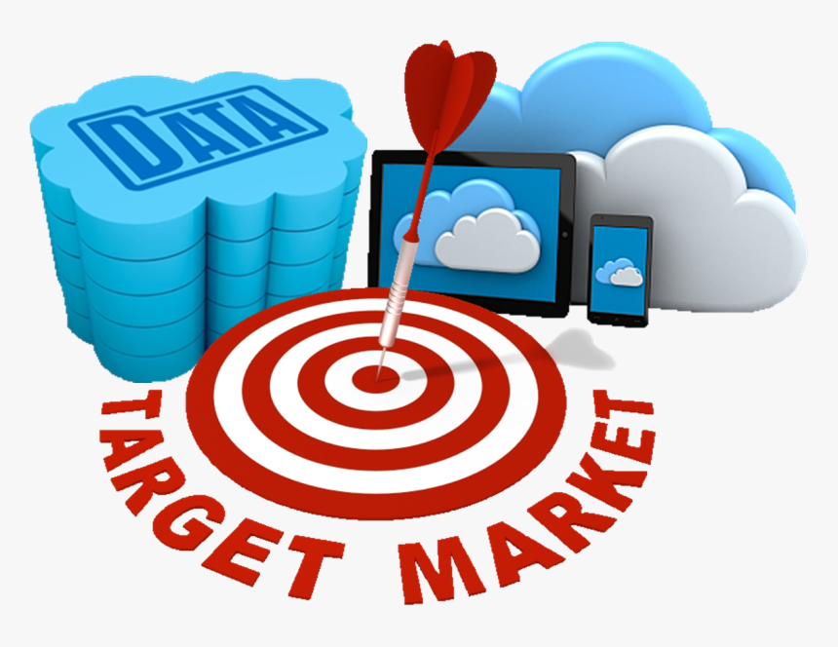
BUSINESS INSIGHTS AND RECOMMENDATION
Group 2- Cream Customers
BUSINESS INSIGHTS:These are the cream customers who have been for a long time now and even do a lot of purchases. They take minimal cash advance and installments to do purchases.They even have a good balance and can afford their buy.
BUSINESS RECOMMENDATION: Make sure not to lose them.Come up with schemes which benefits them the most.

Slide 32

BUSINESS INSIGHTS AND RECOMMENDATION
Group 3- Poor and Inert
BUSINESS INSIGHTS :Their balance is less and don't do purchases.They only buy the necessities and don't take the cash advance and installments to do so.they are a lot in number and have also been there for a good time.
BUSINESS RECOMMENDATION: Focus a lot on them as they are a lot in number and aren't giving much profits.Come up with the schemes that make them comfortable to make purchases in installments and by taking cash advances.

Slide 33
UI

Slide 35
UI Development
In order to develop an interactive and smooth User Interface (UI) to enable the end user for input his/her own inputs and receive model insights, we have used web development frameworks such as HTML, CSS.
We incorporated three model along with user inputs and predict buttons for each of these models that are integrated with the backend using Flask Framework.
Flask is a micro web framework written in python. It is classified as micro framework because it doesn’t require any particular tools and libraries.

Slide 36
Deployment & UI Testing
Flask API was used to deploy the machine learning model in backend. It is used to manage HTTP requests and uses API function to get the data and display the result to the end user in front end UI.
User enters the inputs for all three models, post routing of those values, our machine learning model makes predictions and returns the same.
As a final result, on inputting the user inputs, a backend call routed via Flask framework helps us in providing relevant insights and recommendations to the end user.

Slide 37
CONCLUSION
We were able to load the dataset onto Jupyter IDE and perform relevant analysis and data manipulation for deriving further insights.
Initial Data Quality measures were performed for making the data useful for further analysis.
Exploratory Data Analysis was performed in order to obtain visual information on how the data was impacting certain business requirements. Feature correlations were visualized and their distributions were plotted.
Post EDA, further data quality improvement measures such as Standardization, Normalization and dimensionality reduction techniques were implemented.
Multiple trials of various cluster formation techniques such as DBSCAN clustering, Hierarchical clustering, K means clustering (with/without encoders, with/without PCA) were implemented in order to finalize best possible clustering algorithm to implement the model upon.
Cluster Evaluation techniques such as Elbow Score, silhouette method was used to determine the quality of each of these clusters.
Cluster visualization helped us determine the critical features and their insights to conclude on business recommendations.
UI development using HTML, FLASK API was done in order to create a suitable and interactive UI for determining the clusters based on end user’s inputs

Slide 38
THANK YOU!
ANY QUESTIONS?

Slide 39
Clustering Algorithms in Unsupervised Machine Learning

Slide 40
DBSCAN
DBSCAN (Density-Based Spatial Clustering of Applications with Noise) is a popular learning method utilized in model building and machine learning algorithms. This is a clustering method that is used in machine learning to separate clusters of high density from clusters of low density. Clustering analysis or simply Clustering is basically an unsupervised learning method that divides the data points into a number of specific batches or groups, such that the data points in the same groups have similar properties and data points in different groups have different properties in some sense.

Slide 41
Auto Encoder
Autoencoders are a type of artificial neural network that is used to learn feature representation in an unsupervised manner. It uses the same data for input and output. By adding a bottleneck in the network, it forces the network to create a compressed version of the input data, which is how the encoder works. Meanwhile, the decoder reconstructs the encoded features to its original input.
There are different types of autoencoder models. In a stacked autoencoder model, encoder and decoder have multiple hidden layers for encoding and decoding.
Clustering is difficult to do in high dimensions because the distance between most pairs of points is similar. Using an autoencoder lets you re-represent high dimensional points in a lower-dimensional space. It doesn't do clustering per se - but it is a useful preprocessing step for a secondary clustering step. You would map each input vector xixi to a vector zizi (not a matrix...) with a smaller dimensionality, say 2 or 3. You'd then use some other clustering algorithm on all the zizi values

Slide 42
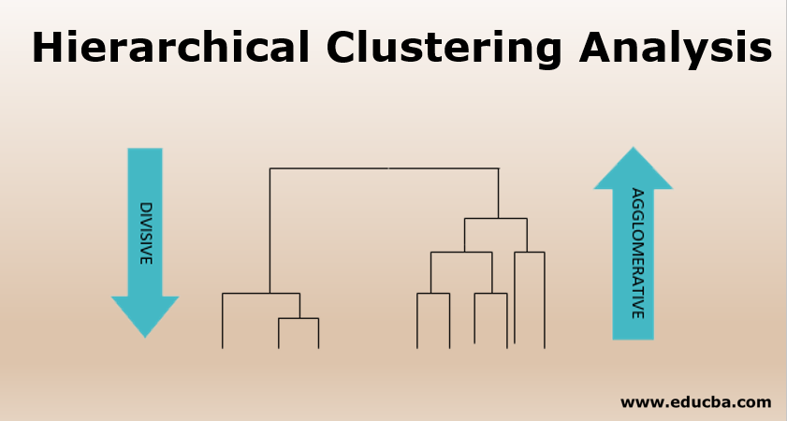
HIERARCHICAL CLUSTERING
Hierarchical clustering, also known as hierarchical cluster analysis, is an algorithm that groups similar objects into groups called clusters. The endpoint is a set of clusters, where each cluster is distinct from each other cluster, and the objects within each cluster are broadly similar to each other.
Hierarchical clustering can be performed with either a distance matrix or raw data. When raw data is provided, the software will automatically compute a distance matrix in the background.

